Slide 1

ANOVA Using R
PsychoStat

Slide 2
Agenda
One-Way ANOVA
Multiple Comparisons/Posthoc Tests
2-way Factorial ANOVA
3-way Factorial ANOVA
Unequal Sample Sizes

Slide 3

One-Way ANOVA in R
PsychoStat

Slide 4
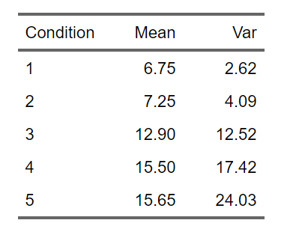
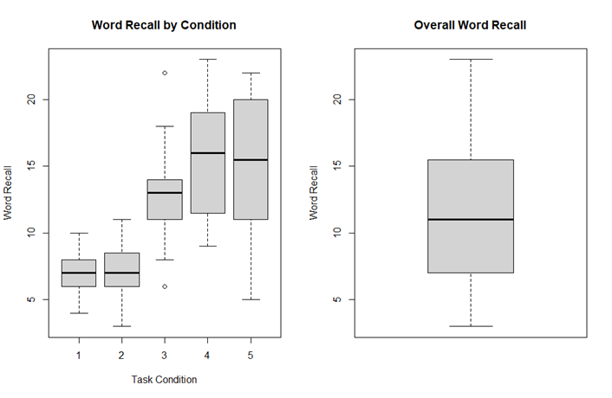
Does Word Recall Vary by Task Complexity?

Slide 5
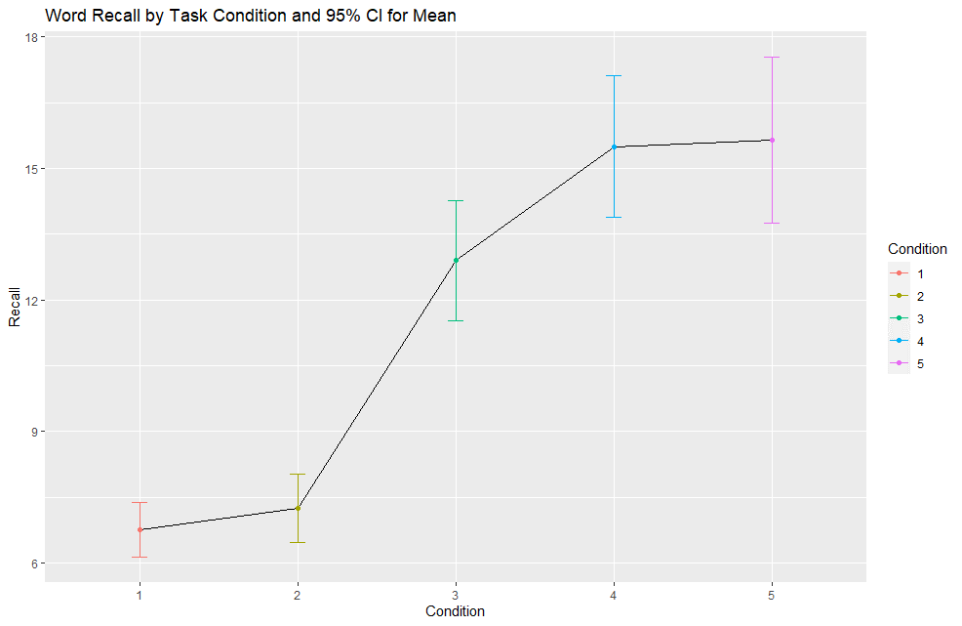
One-way ANOVA: Word Recall ~ Task Condition
 | df | Sums of Sq. | Mean Sq | F value | p | Eta Sq.
Condition | 4 | 1514.94 | 378.70 | 31.21 | < .001 | 0.57 [.45, .65]
Residuals | 95 | 1152.85 | 12.10
Total | 99 | 2667.79

Slide 6
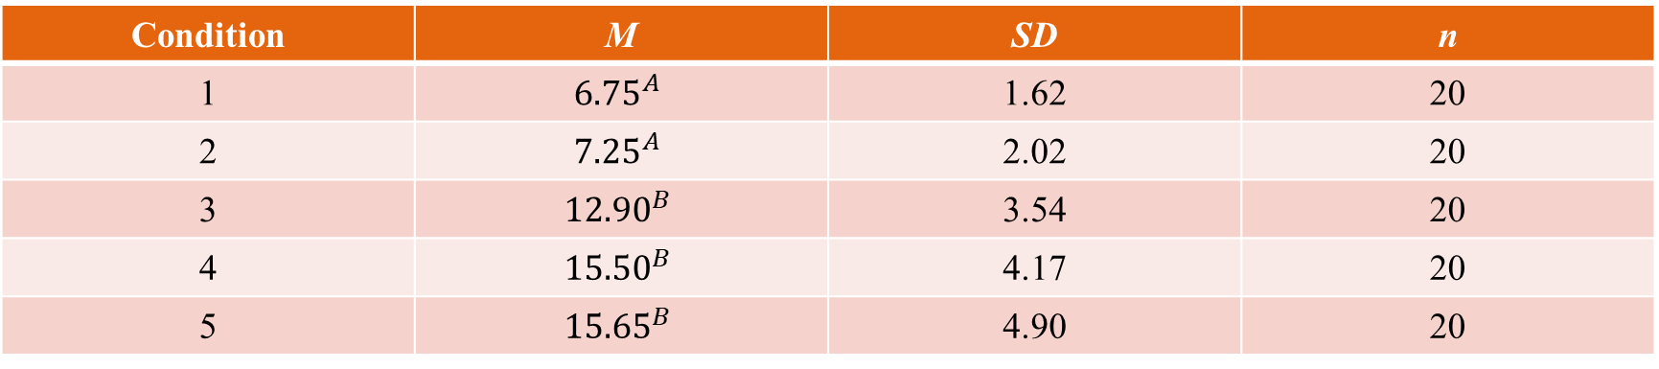
Fancy Write-Up: Word Recall ~ Task Condition
Condition | M | SD | n
1 | $${6.75}^{A}$$ | 1.62 | 20
2 | $${7.25}^{A}$$ | 2.02 | 20
3 | $${12.90}^{B}$$ | 3.54 | 20
4 | $${15.50}^{B}$$ | 4.17 | 20
5 | $${15.65}^{B}$$ | 4.90 | 20
Note. Means sharing a superscript do not differ significantly at the Holm-adjusted .05 level
Study participants’ word recall scores were significantly related to the cognitive complexity of the memory task they engaged in beforehand, F(4, 95) = 31.21, MSE = 12.10, p < .001, η² = .57, 90% CI [.45, .65]. As shown in Table 1, mean number of words recalled was significantly less for participants who engaged in the Level 1 & 2 complexity tasks than participants who engaged in Level 3, 4, & 5 tasks. All other comparisons fell short of statistical significance.

Slide 7
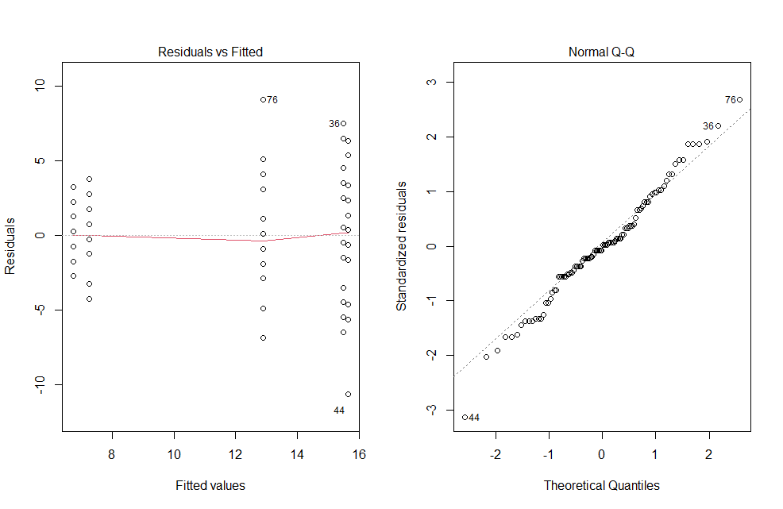
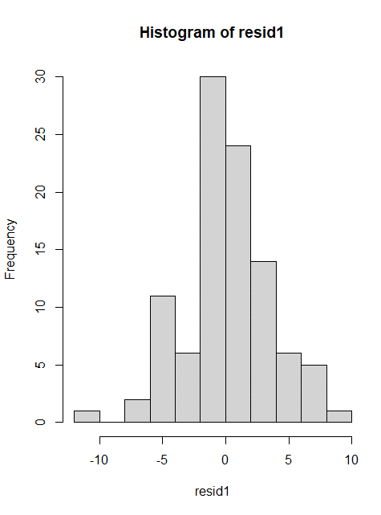
Diagnostics: Word Recall ~ Task Condition

Slide 8

Factorial ANOVA in R
PsychoStat

Slide 9
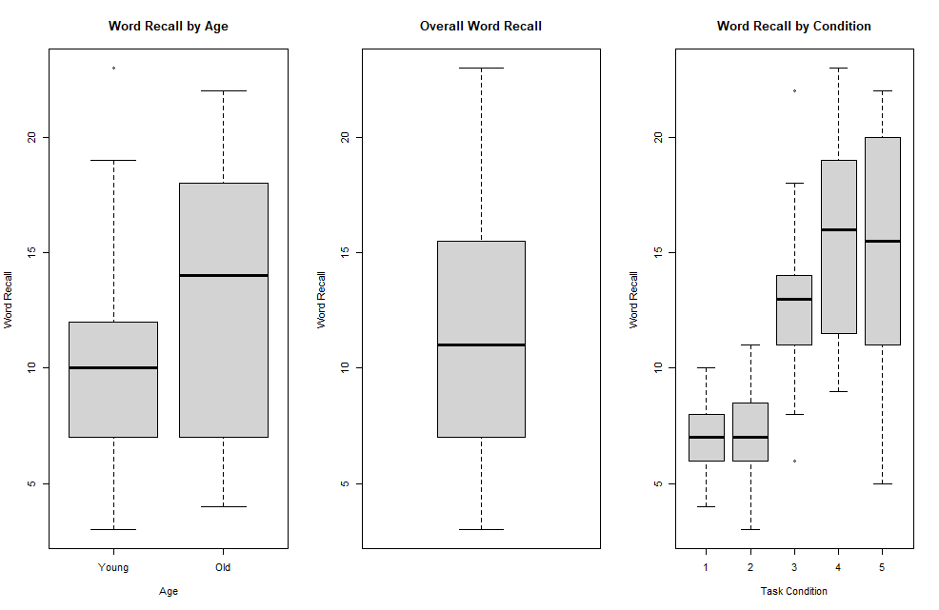
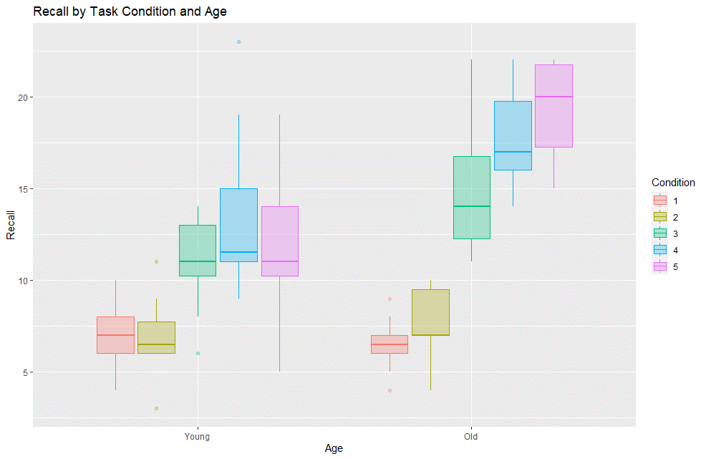
Does Word Recall Vary by Task Complexity and Age?

Slide 10
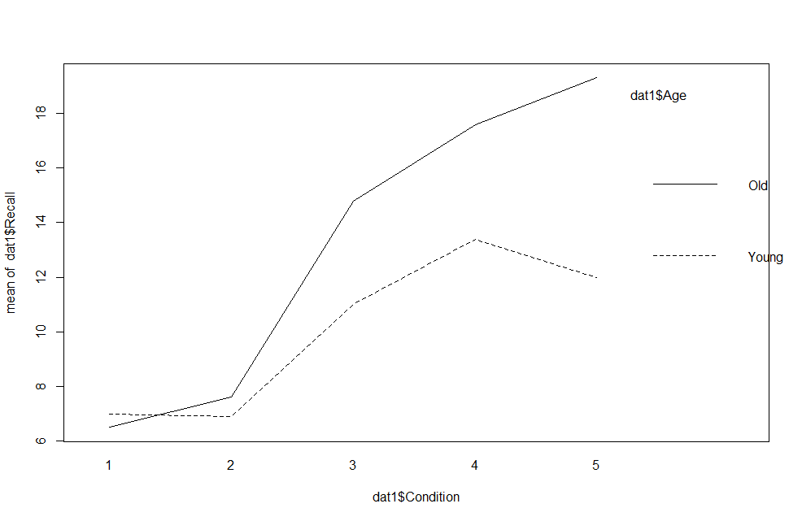
2-Way ANOVA: Word Recall ~ Task Condition*Age
 | df | Sums of Sq. | Mean Sq | F value | p | Eta Sq.
Condition | 4 | 1514.94 | 378.70 | 47.19 | < .001 | 0.57 [.45, .65]
Age | 1 | 240.30 | 240.30 | 29.94 | < .001 | 0.09 [.02, .19]
Condition*Age | 4 | 2667.79 | 47.62 | 5.93 | < .001 | 0.07 [.00, .14]
Residuals | 90 | 722.31 | 8.00
Total | 99 | 2667.79

Slide 11
Simple Main Effect of Condition by Age Group
One-Way ANOVA of Recall ~ Condition for Young Group
 | df | Sums of Sq. | Mean Sq | F value | p | Eta Sq.
Condition | 4 | 351.50 | 87.88 | 9.09 | < .001 | .45 [.24, .57]
Residuals | 45 | 435.30 | 9.67
Total | 49 | 2667.79
One-Way ANOVA of Recall ~ Condition for Old Group
 | df | Sums of Sq. | Mean Sq | F value | p | Eta Sq.
Condition | 4 | 1353.70 | 338.40 | 53.06 | < .001 | .83 [.74, .87]
Residuals | 45 | 287.00 | 6.40
Total | 49 | 1670.70

Slide 12
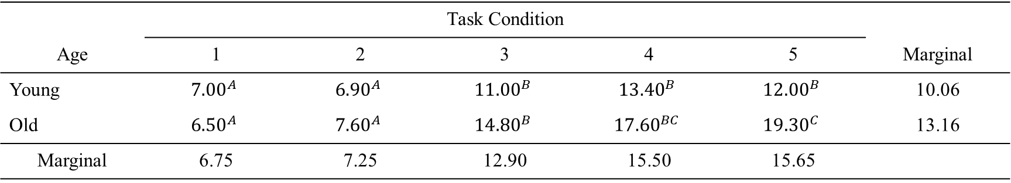
Results: Word Recall ~ Task Condition*Age
 | Task Condition
Age | 1 | 2 | 3 | 4 | 5 | Marginal
Young | $${7.00}^{A}$$ | $${6.90}^{A}$$ | $${11.00}^{B}$$ | $${13.40}^{B}$$ | $${12.00}^{B}$$ | 10.06
Old | $${6.50}^{A}$$ | $${7.60}^{A}$$ | $${14.80}^{B}$$ | $${17.60}^{BC}$$ | $${19.30}^{C}$$ | 13.16
Marginal | 6.75 | 7.25 | 12.90 | 15.50 | 15.65
Note. Within each row, means sharing a superscript do not differ significantly at the Holm-adjusted .05 level
The positive trend of increased task complexity being associated with greater recall is present for both age groups, but to a greater degree in the older participants
The trend seems to “level off” for the younger participants, but the old
Indicates that for older participants cognitive exercises are especially important for memory?
The effect size (eta-squared) of condition was noticeably greater for the older participants than for the younger participants

Slide 13
Fancy Write-Up: Word Recall ~ Task Condition*Age
A 5 x 2 Condition x Age factorial ANOVA was employed to investigate the effects of age group and task complexity upon word recall. Each effect was tested with a MSE of 8.0. Significant (p < .05) effects were found for the main effect of condition, F(4, 90) = 47.19, p < .001, the main effect of age, F(1, 90) = 29.94, p < .001, and the Condition x Age interaction, F(4, 90) = 5.93, p < .001. The significant interaction was further investigated by testing the simple main effects of task condition for each age group level. For the younger participants, task condition had a significant effect upon recall, F(4, 45) = 9.09, p < .001, η² = .45, 90% CI [.24, .57]. Pairwise comparisons conducted using Tukey HSD tests indicated that for the younger participants, those who engaged in task conditions 1 & 2 recalled significantly fewer words than those in conditions 3, 4, & 5. All other comparisons for the younger participants fell short of significance. In contrast, for the older participants, task condition had a significant effect upon recall, F(4, 45) = 53.06, p < .001, η² = .83, 90% CI [.74, .87]. For the older participants, those who engaged in task conditions 1 & 2 recalled significantly fewer words than those in conditions 3, 4, and 5 and those who engaged in condition 5 also recalled significantly more words than those in condition 3.

Slide 14
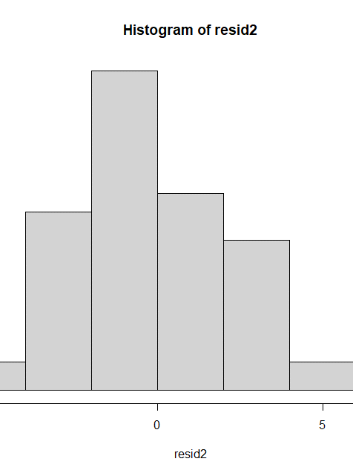
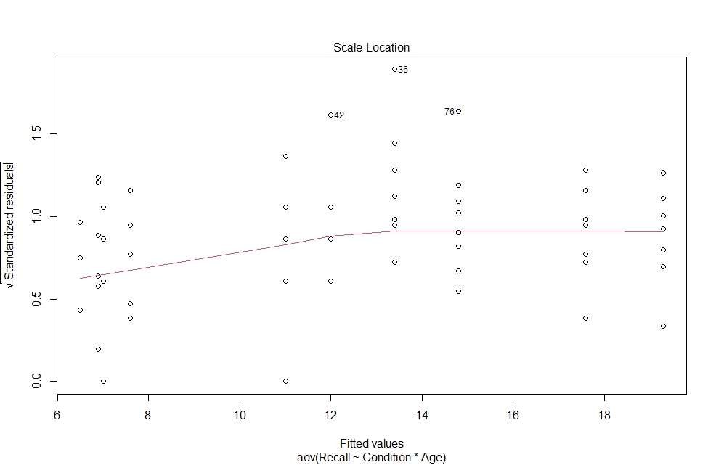
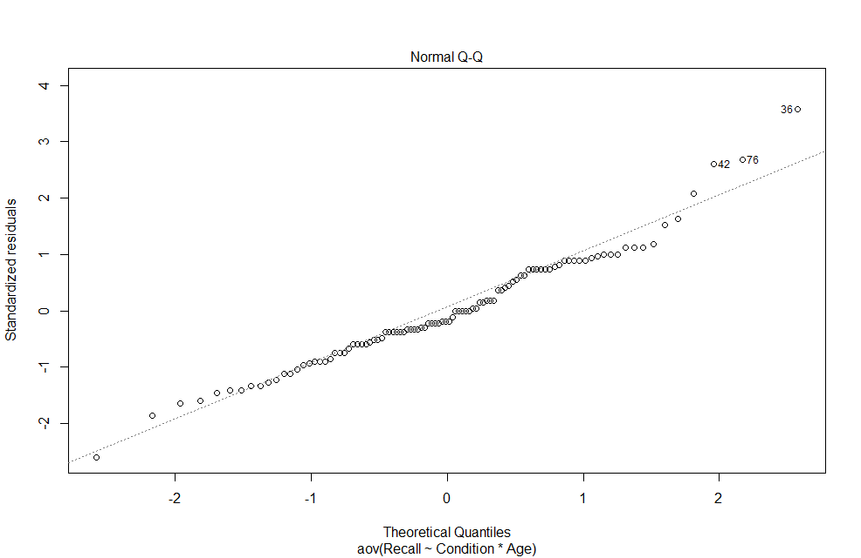
Diagnostics: Word Recall ~ Task Condition*Age

